Slide 1

Jeein Park
About Me
Projects
Tech Stack
Contact me

Slide 2
Jeein Park
About Me
Projects
Tech Stack
Contact me

Slide 3
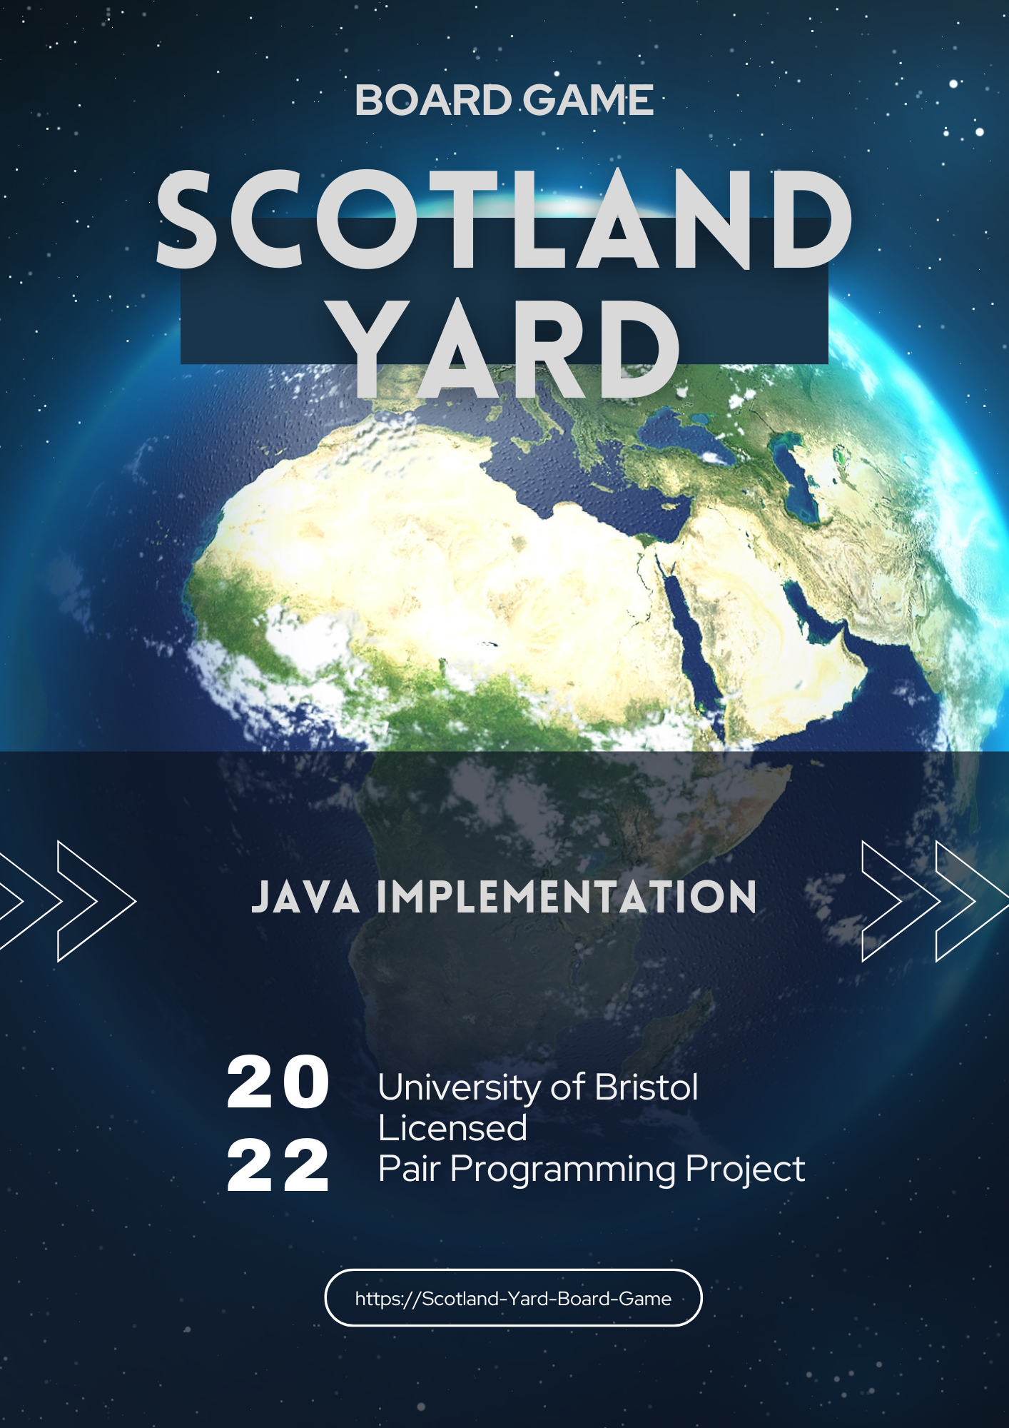
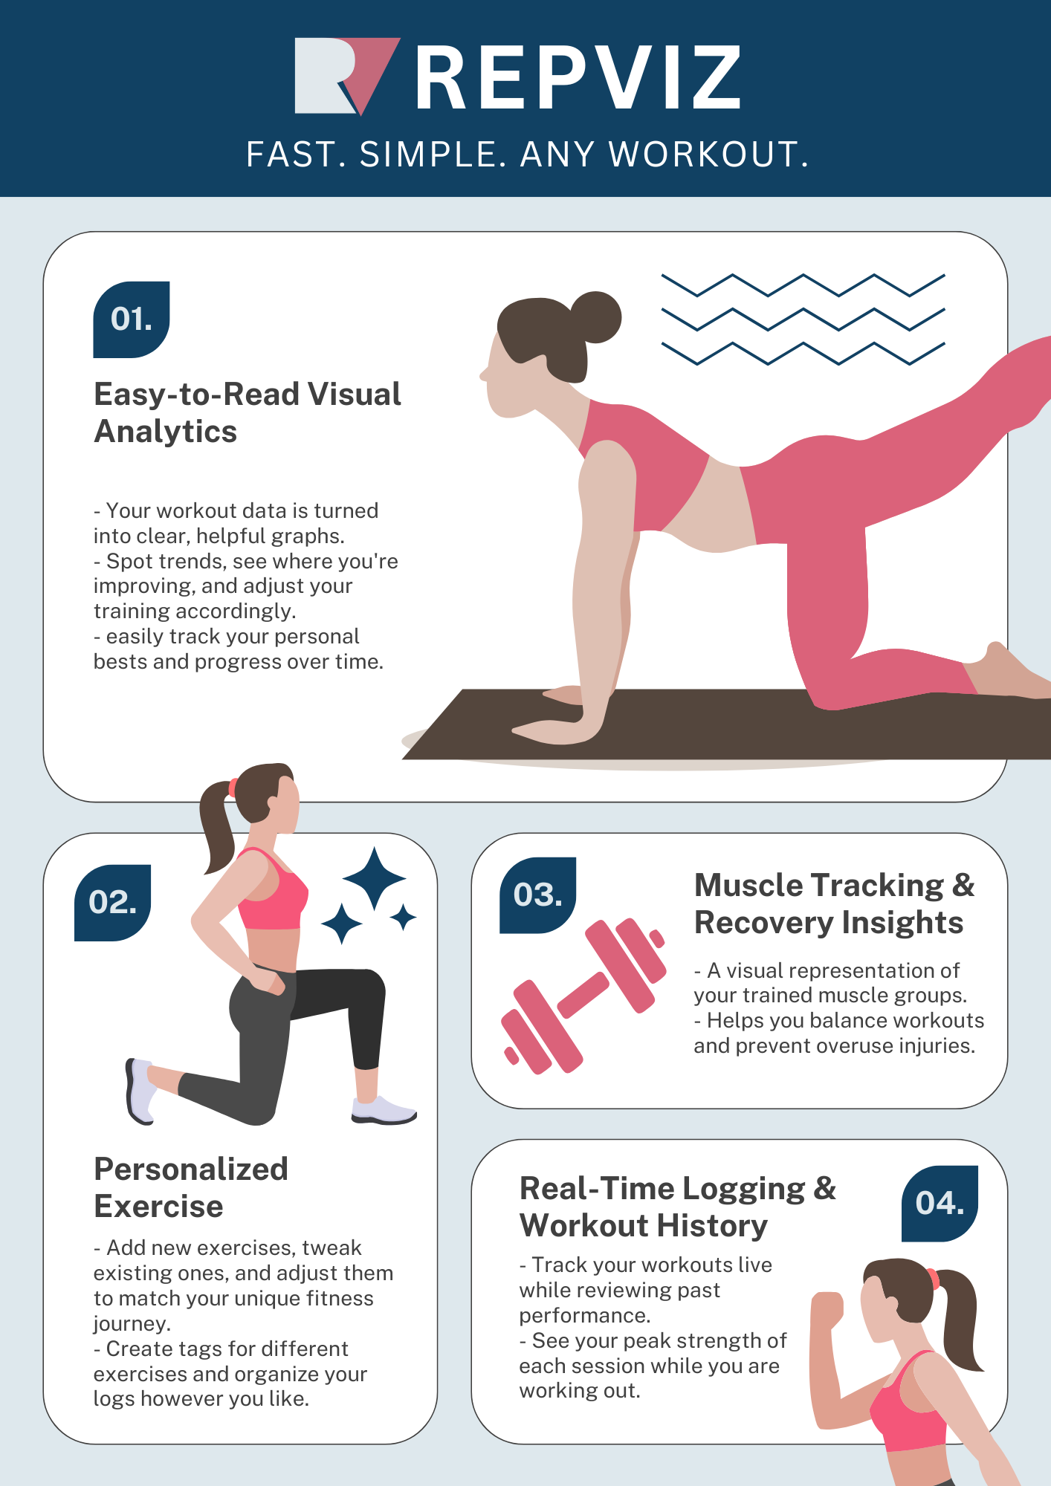




Jeein Park
About Me
Projects
Tech Stack
Contact me
# Deployment
# Deployment
# Deployment
# Kotlin
# MVVM
# Kotlin
# MVVM
# Kotlin
# MVVM
# Jetpack Compose
# Jetpack Compose
# Jetpack Compose
# App testing
# App testing
# App testing
# Deployment
# Deployment
# Deployment
# Kotlin
# MVVM
# Kotlin
# MVVM
# Kotlin
# MVVM
# Jetpack Compose
# Jetpack Compose
# Jetpack Compose
# App testing
# App testing
# App testing

Slide 4
Home
About Me
Projects
Tech Stack
Contact me
Jeein Park

